Slide 1
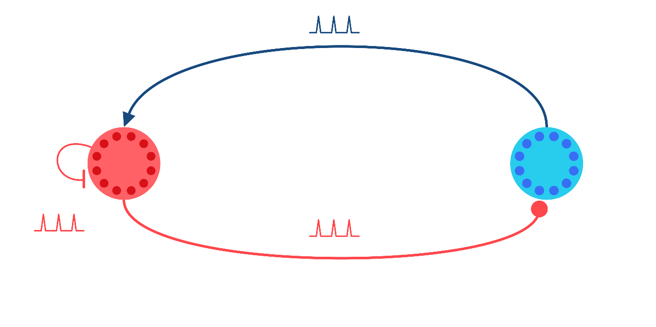




Closed-loop Control of Neural Activity Dynamics
$$+$$
Thijs Lenssen
Supervisor: Amritam Das
$$−$$
P₂
P₁
$$−$$

Slide 2
Sensing – Neural – Actuation Modeling
Single Neural Dynamics
Leaky Integrate-and-Fire (Switching)
Hodgkin Huxley Model (PDE rep)
FitzHugh-Nagumo (Simplification)
Neural Population Dynamics
Neural Mass Models (lumped)
Neural Field Models (distributed)
Dynamical Models in Neuroscience From a Closed-Loop Control Perspective, Martinez et. Al. (2023)

Slide 3
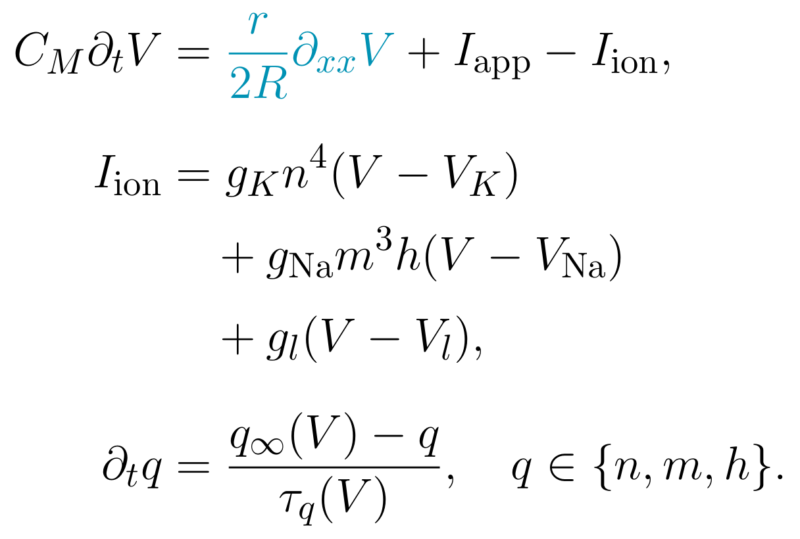
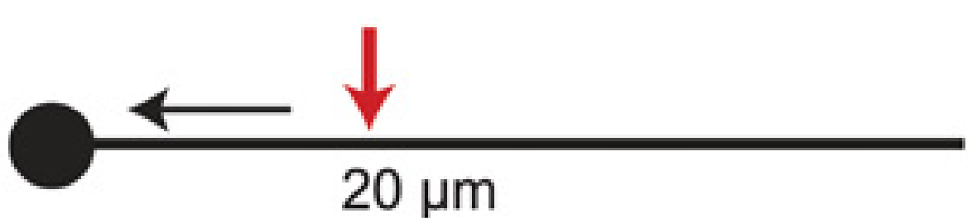
Distributed Hodgkin-Huxley model
An excitable membrane at each position along the axon
Dendrites
Voltage and local channel dynamics
I_app(x,t)
Axon
V(x,t)
Soma
x = 0
x = L
distance along the axon
The cable equation models the axon; dendrites and soma are shown for context.
Schematic: Brette (2015), Fig. 5C, adapted (CC BY). Model: Martinez et al. (2023), Eqs. (8)-(9).
Msc Defence T.M. Lenssen
Notes:
The left schematic adds dendritic branches to the soma-axon portion of Brette (2015), Figure 5C. The original current direction marker and distance label are covered; the red current injection arrow is retained. These labels illustrate the distributed HH model rather than the quantitative experiment of that original panel.
Schematic source: Romain Brette (2015), What Is the Most Realistic Single-Compartment Model of Spike Initiation?, PLoS Computational Biology 11:e1004114, Figure 5C; CC BY. https://doi.org/10.1371/journal.pcbi.1004114. That figure adapts Brette (2013), https://doi.org/10.1371/journal.pcbi.1003338.
Model source: Martinez et al. (2023), Dynamical Models in Neuroscience From a Closed-Loop Control Perspective, p. 708, Eqs. (8)-(9). https://doi.org/10.1109/RBME.2022.3180559.
The voltage PDE is for a uniform unmyelinated axon. V, n, m and h are functions of x and t. q is shorthand for each of n, m, h; therefore the displayed q equation denotes three local gating equations. n is K activation; m is Na activation; h is Na inactivation. The sodium, potassium and leak currents are explicitly expanded.
Dendrites and soma provide anatomical context. They require a branched cable/compartment extension and appropriate interface conditions to model explicitly. This is an individual-neuron model, not a population-rate model. Initial/boundary conditions, kinetics and parameters must be supplied for simulation.

Slide 4
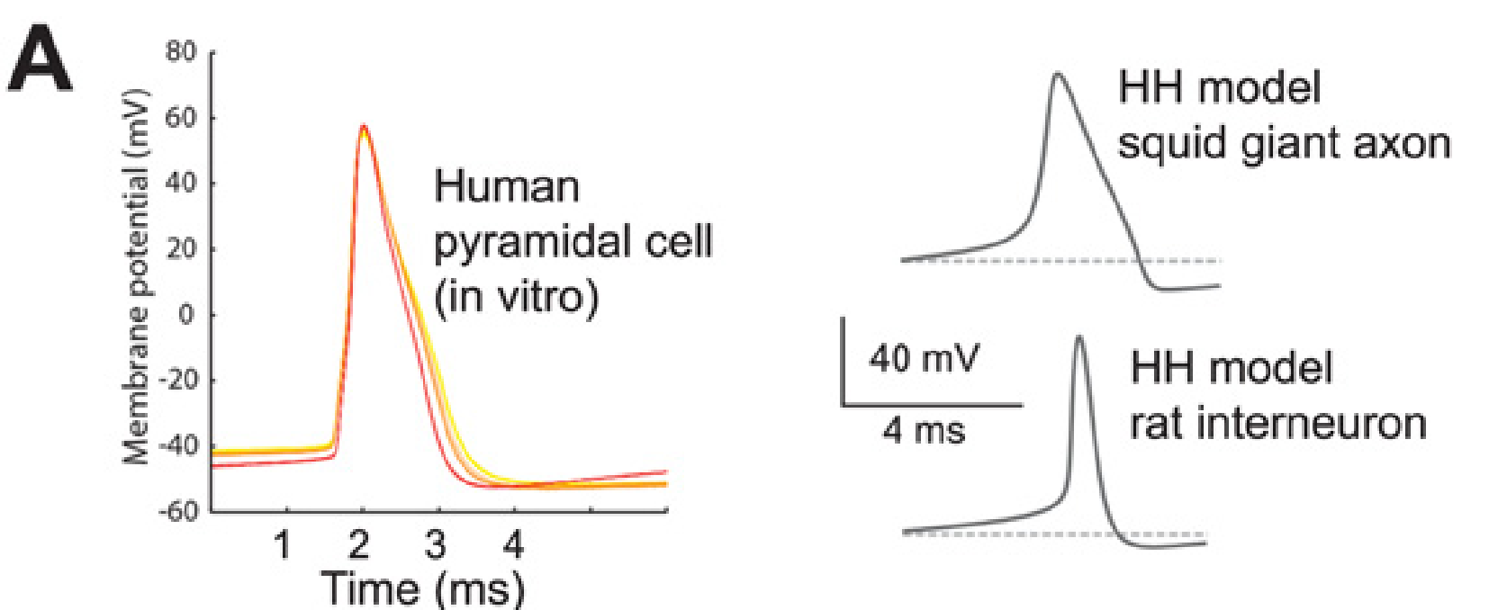
Hodgkin Huxley Model
Spike-onset comparison across different preparations; not a fit to the same cell.
Brette (2015), Fig. 3A; adapted from Testa-Silva et al. (2014) and Sengupta et al. (2010). CC BY.
Notes:
Brette (2015), What Is the Most Realistic Single-Compartment Model of Spike Initiation?, PLoS Computational Biology 11:e1004114, Figure 3A (PDF page 6). https://doi.org/10.1371/journal.pcbi.1004114
Left: recorded human pyramidal-cell action potentials in vitro. Right: single-compartment HH examples for squid giant axon and rat interneuron. These are different preparations, not a model fitted to the recorded cell. The comparison concerns spike-onset shape, not a validation of the distributed HH cable model.
Brette credits Testa-Silva et al. (2014), https://doi.org/10.1371/journal.pbio.1002007, and Sengupta et al. (2010), https://doi.org/10.1371/journal.pcbi.1000840. Figure reproduced under the article Creative Commons Attribution license. The original plotted data, labels and scale bars are retained.

Slide 5
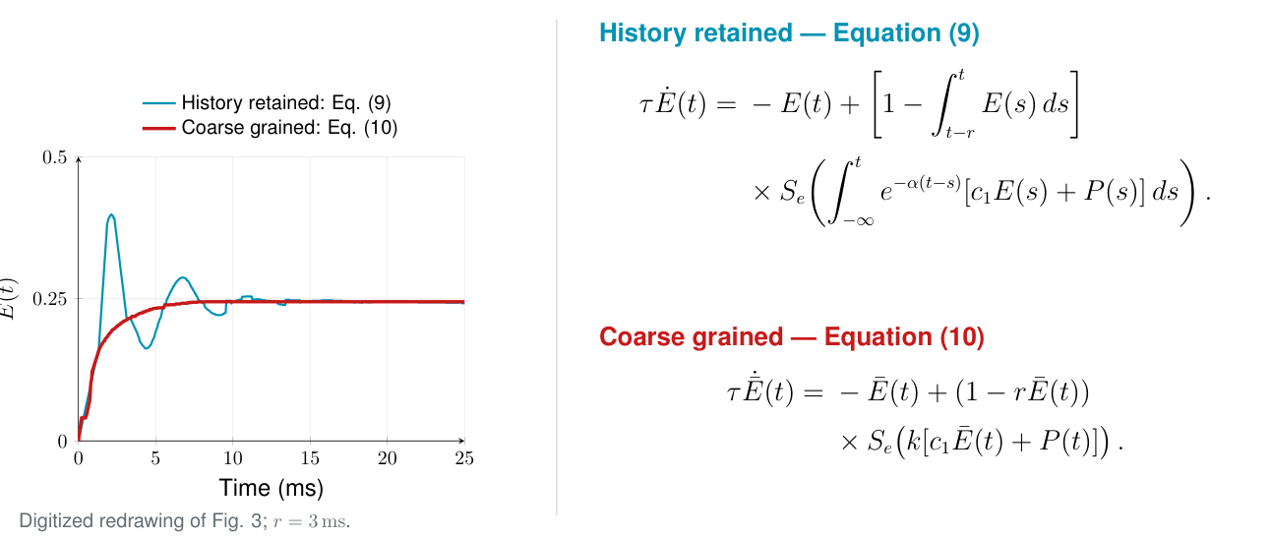
Population activity: temporal coarse graining
Excitatory population only: explicit memory versus temporal averaging
Wilson and Cowan (1972), Fig. 3 and Eqs. (9)-(10). Curves digitized from the published scan.
Notes:
Wilson and Cowan (1972), Excitatory and Inhibitory Interactions in Localized Populations of Model Neurons, Biophysical Journal 12:1-24. Figure 3 on p. 10 and Eqs. (9)-(10) on p. 8. https://doi.org/10.1016/S0006-3495(72)86068-5
This is a digitized graphical redrawing of the published curves, not an independently reproduced simulation. The caption specifies r=3 ms but does not give a complete parameter set, response function, input waveform and initial history for Figure 3. The parameters listed for Figure 4 are not assumed to be those of Figure 3.
The blue curve is sampled from pixels of the thin oscillatory curve; the red curve is sampled from the thick coarse-grained curve. A monotone isotonic fit removes raster noise from the coarse curve. Spatial calibration in the rendered crop: t=0 at x=155, t=25 ms at x=745; E=0 at y=647 and E=0.5 at y=63. The source page is rendered at 6x with clip (170,475,305,615). Data are stored in wc1972_fig3_history.csv and wc1972_fig3_coarse.csv; the digitization script and PGFPlots source are included in Presentation/.
Equation (9) already uses a first-order expansion of the original response delay and omits inhibition for this comparison. It retains the refractory moving integral and exponentially weighted synaptic input. Its exponential is reproduced as printed, exp[-alpha(t-s)]; alpha is therefore a decay-rate coefficient in the displayed equations. Equation (10) replaces the histories by coarse-grained values and gain k.

Slide 6
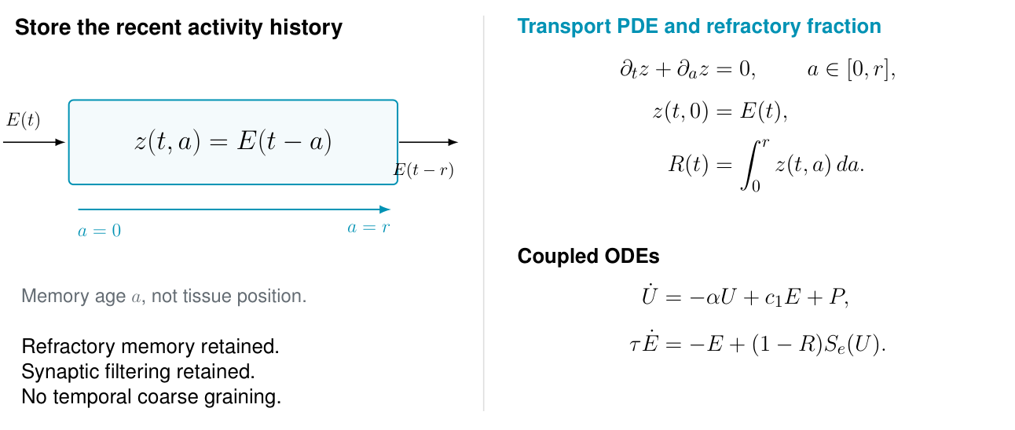
Retaining population memory with transport
An equivalent realization of Equation (9), with compatible initial history
Transport formulation derived from Wilson and Cowan (1972), Eq. (9). The extra coordinate is memory age.
Notes:
Derived here from Eq. (9) in Wilson and Cowan (1972), rather than an equation quoted from the paper. https://doi.org/10.1016/S0006-3495(72)86068-5
Define z(t,a)=E(t-a), a in [0,r]. Then z_t+z_a=0, z(t,0)=E(t), and R(t)=integral_0^r z(t,a) da is exactly the refractory integral in Eq. (9). The coordinate a is history age, not physical tissue position.
Define U(t)=integral_{-infinity}^t exp[-alpha(t-s)] [c1 E(s)+P(s)] ds. Then U_dot=-alpha U+c1 E+P. The population ODE tau E_dot=-E+(1-R)S_e(U) is exactly Eq. (9). Thus this PDE-ODE system retains the two histories in Eq. (9), without the extra temporal coarse-graining that yields Eq. (10).
Consistent initialization is essential: z(0,a)=E_history(-a), and U(0) equals the convolution of the past excitation and input. Boundary compatibility also requires z(0,0)=E(0). If histories vanish before zero, use z(0,a)=0 and U(0)=0, with compatible E(0).
The transport formulation is equivalent to Eq. (9), which itself already approximates the original delayed response in Eqs. (3)-(4). It does not undo that earlier response-delay approximation. No extra PDE simulation curve is claimed in the digitized Figure 3.
For constant signals and this unnormalized exponential, the convolution DC gain is 1/alpha; k in Eq. (10) denotes the coarse-graining gain. Polynomial/constant coefficients appear in the transport and filter realization. The remaining sigmoid and refractory-factor product are nonlinear.

